Slide 1
Recommendations for Property Valuation for Kings County Real Estate
SHIMNAZ FATHIMA

Slide 2
Outline of the Presentation
Project Overview
Data sources for analysis
Methodology of the project
Results of the analysis
Inferences

Slide 3
Project Overview
This project involves analysing sales data for Kings County properties.
Multi-linear regression analysis was performed on this data
Conclusions were derived from this analysis to provide Kings County Real Estate Agency.

Slide 4
Methodology
Multi-linear regression was performed over 4 iterations.
Initially the outliers were eliminated, and data was well understood.
Check for linear regression theory assumptions was done.
Check for multicollinearity was done and dummy variables were introduced.
Log transformation and feature scaling was done to improve the model
Key features were identified.
Model validation was finally performed.

Slide 5
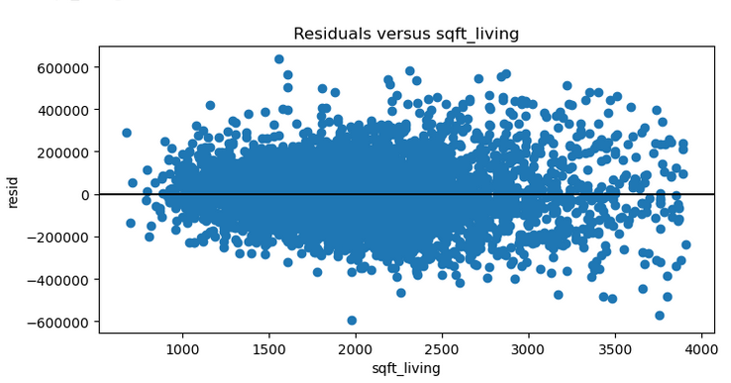
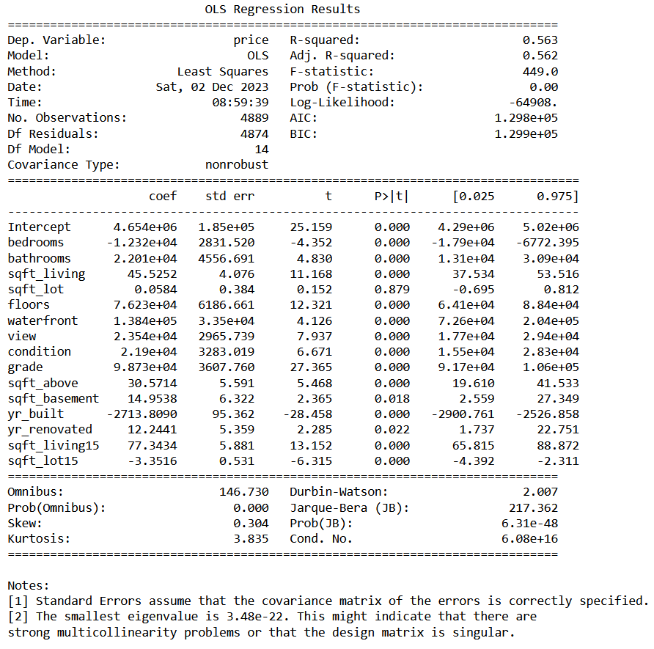
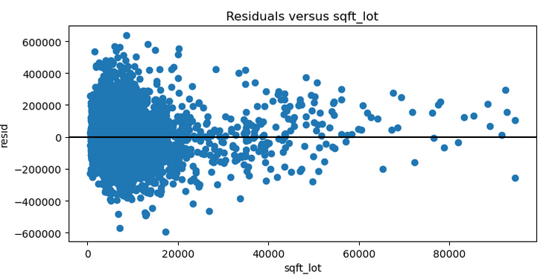
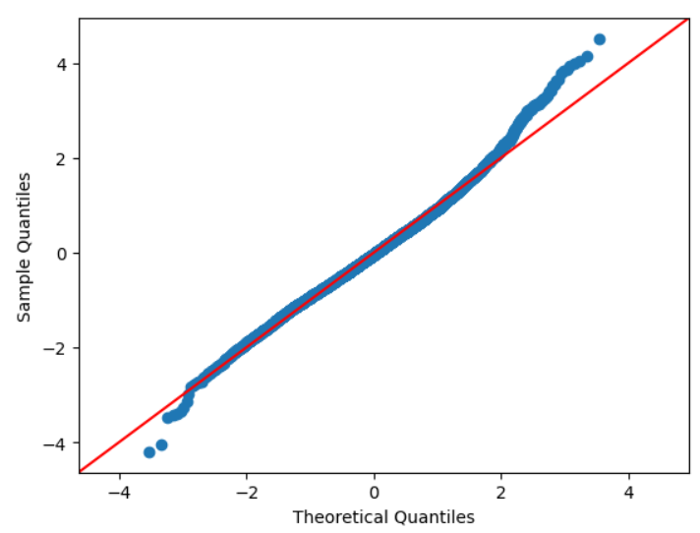
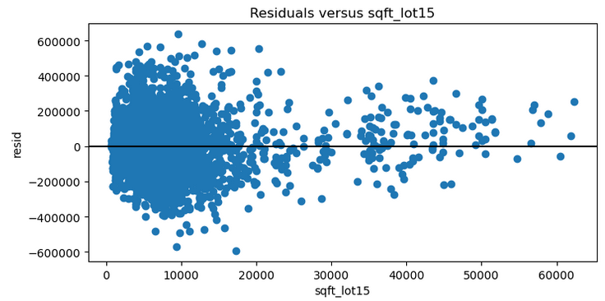
Results of the Analysis
1st Iteration

Slide 6
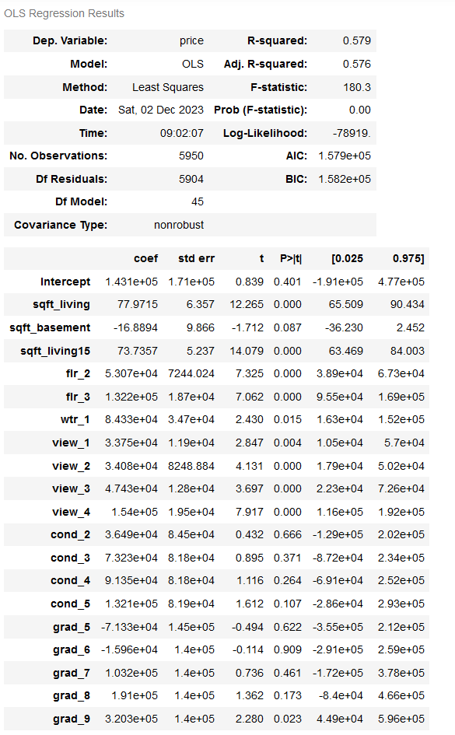
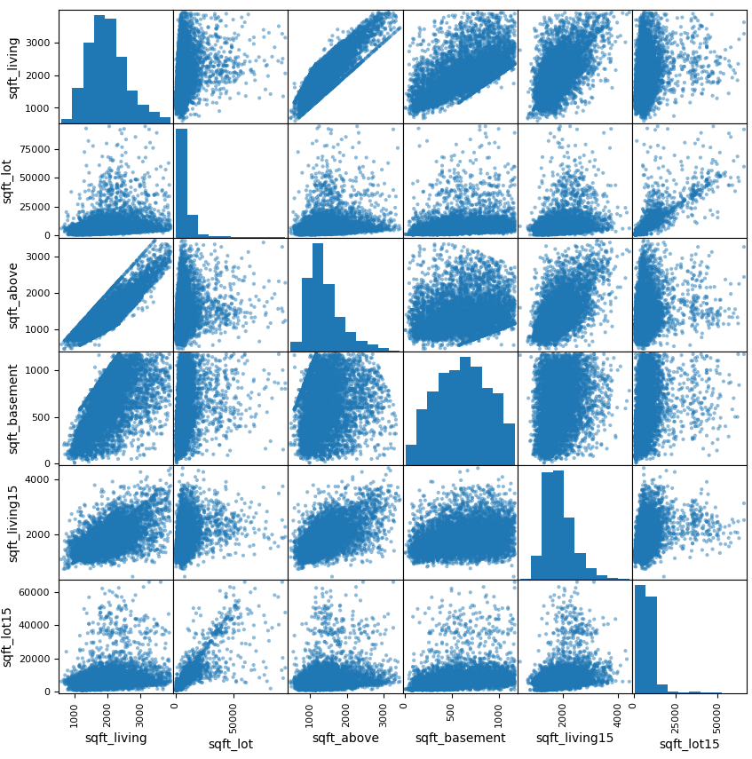
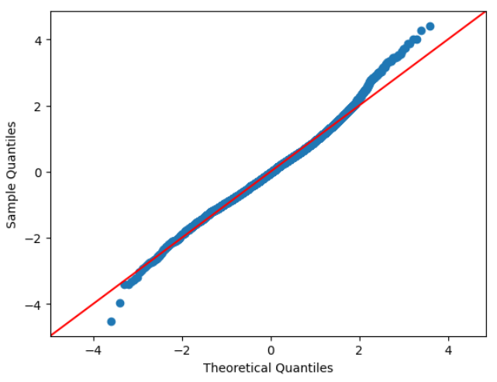
Results of the Analysis
2nd Iteration

Slide 7
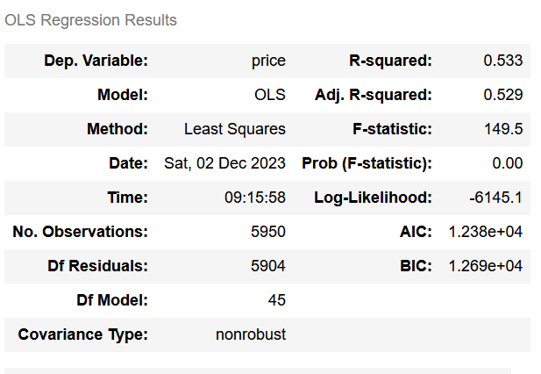
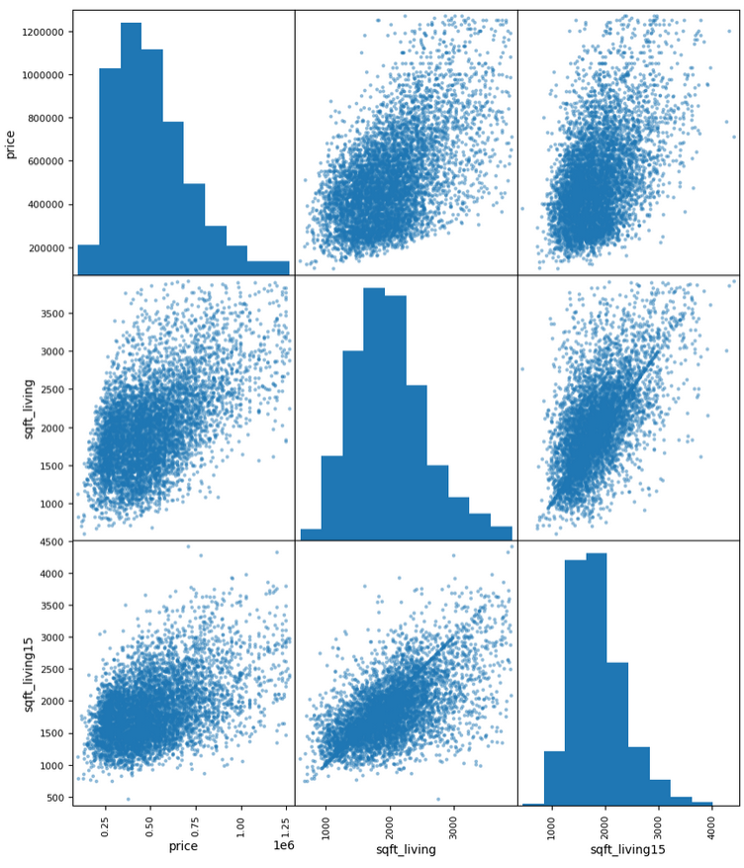
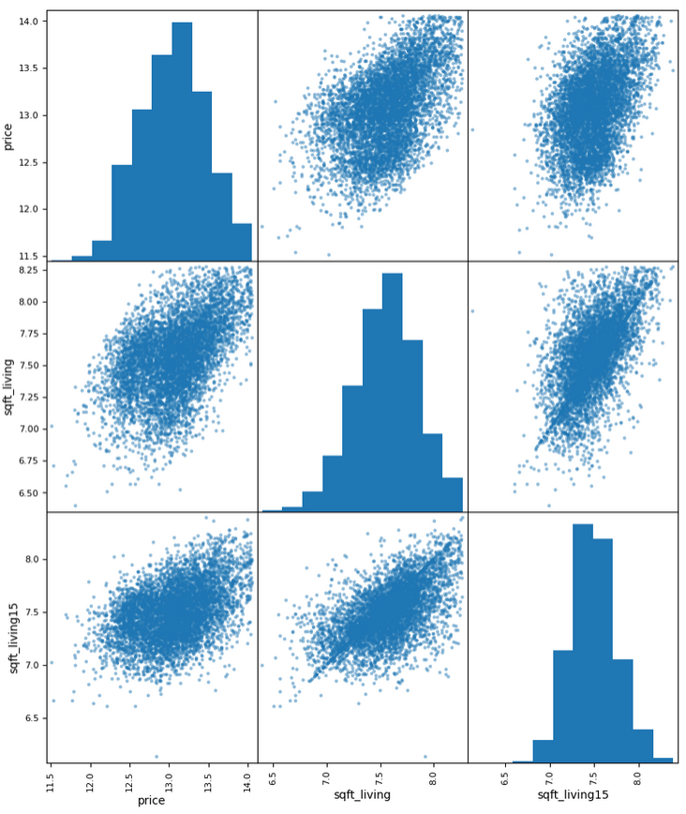
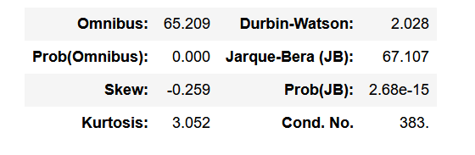
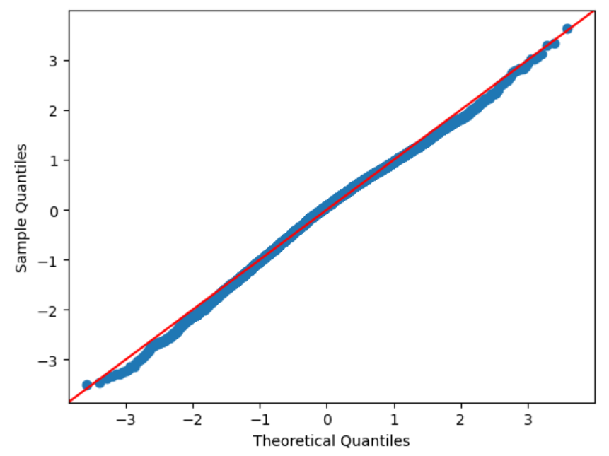
Results of the Analysis
3rd Iteration

Slide 8
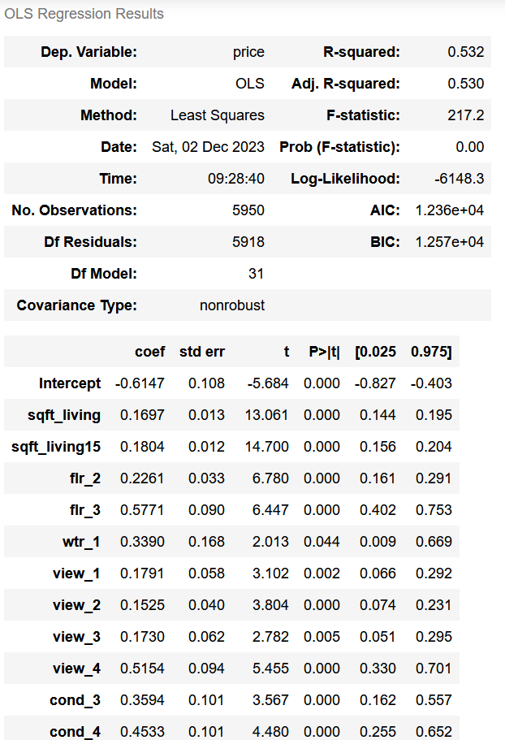
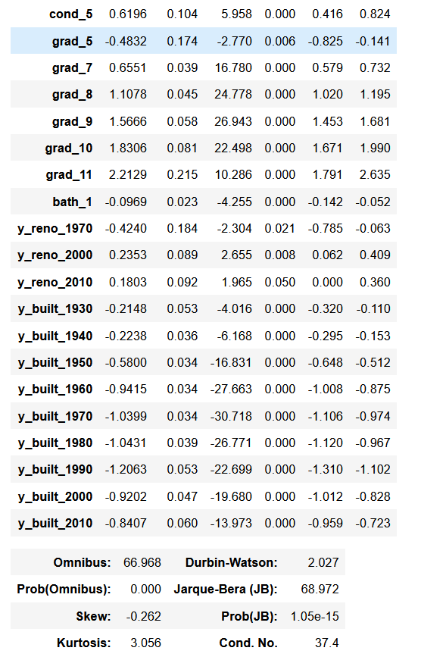
Results of the Analysis
4th Iteration
Some of the key features identified:
Sqft_living
Grade (particularly on the higher scale)
Sqft_living15
No of Floors
Condition

Slide 9
Results of the Analysis
Model Validation
Data set divided into:
Training data 12471 datapoints
Testing Data 4157 data points
Train Mean Squared Error: 0.103365
Test Mean Squared Error: 0.103383

Slide 10
Inferences
The following inferences can be derived from the results:
Based on the coefficients, the features with high impact on the price are sqft_living, floors, waterfront, condition, grade and renovation.
For targeting high price properties:
The number of floors of the house can influence the price. The log of the price will increase by 0.23-0.578 by having 2-3 floors. Which means, there will be an increase of price by 1.26-1.78 times
Having a waterfront property can improve the price by 1.4 times the value of the property.
Better the condition and grade (in terms of the Kings County Grading system), better will be the price of the property.

Slide 11
Inferences
Recommendations that could be provided to sellers looking to improve the value of the house:
Doing a renovation can increase the value of the house by around 1.25 times the value of the house.
Properties with just one bathroom depreciated the value of the house by 0.91 times. Increasing the number of bathrooms while doing the renovations would be recommended.

